Slide 1
Green University of Bangladesh
Department of Computer Science & Engineering
Subject: Electronics Lab
Course Code:EEE-204
Our group Project Presentation topic :Rectifier
Submitted To:
Name :Sakib Abdul Ahad
Designation : Lecturer
Department : EEE
Green University of Bangladesh
Submitted by :
Name : Md.Nur A Neouse
ID : 193002093
Name : Jakirul Islam
ID :193002101
Name : Nazifa Alam Nowrin
ID :193002103

Slide 2
Outline
Definition and types of Rectifier
Half wave rectifier
Operation of half wave rectifier
Full wave rectifier
Two diodes full wave rectifier
Operation of two diodes full wave rectifier
Full wave bridge rectifier
Operation of full wave bridge rectifier
Summery of full wave bridge rectifier.

Slide 3
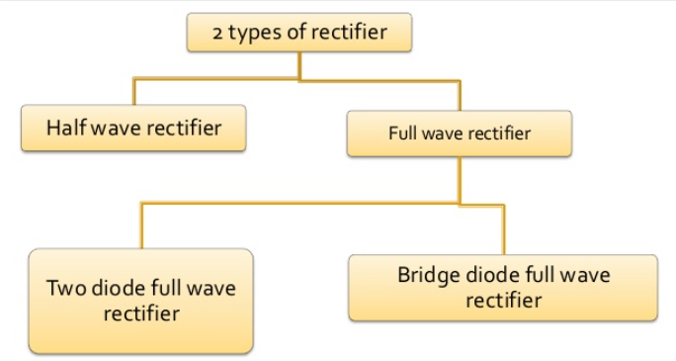
Defination And types of Rectifier
Rectifier is an electronic circuit that converts alternating current (AC) into direct current (DC)

Slide 4
Half Wave Rectifier

Slide 5
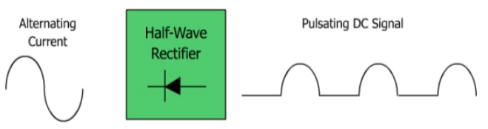
Half wave rectifier
The rectifier that removes one-half the input signal to establish a dc level is called half wave rectifier

Slide 6
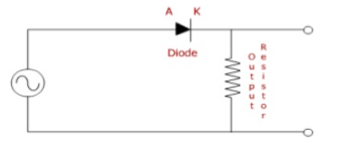
Half wave rectifier
A half Wave rectifier is shown below.

Slide 7
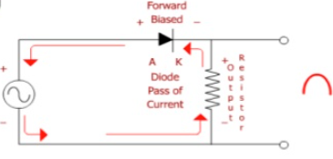
The operation of half Wave Rectifier
During the positive alternation

Slide 8
Full Wave Rectifier

Slide 9
Full Wave Rectifier
A rectifier that can produce ripple voltage during both positive and negative input cycle is called full wave rectifier.
There are 2 types of full wave rectifier:
I. Two diodes full wave rectifier
II. Bridge rectifier

Slide 10
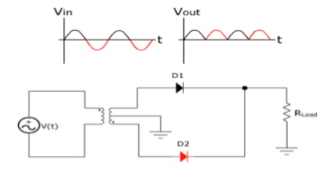
Two Diodes Full Wave Rectifier
The Full Wave Rectifier is the equivalent of two half- wave rectifier.

Slide 11
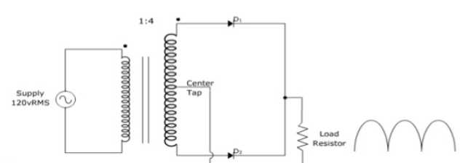
Two Diodes Full Wave Rectifier
A full wave rectifier with diodes and a 1 to 4 step-up transformer is shown here.

Slide 12
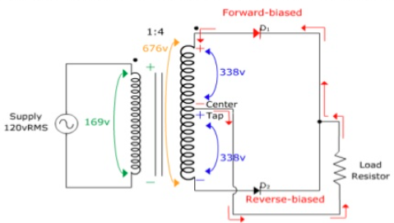
Two Diodes Full Wave Rectifier
positive alternation
The following circuit conditions exist when the positive alternation of the AC supply voltage is applied to the transformers primary.

Slide 13
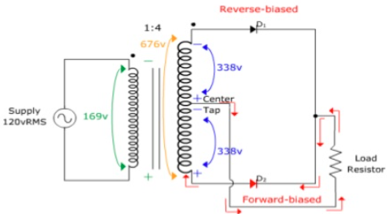
Two Diodes Full Wave Rectifier
negative alternation
The following circuit conditions exist when the negative alternation of the AC supply voltage is applied to the transformers primary.

Slide 14
Full Wave Bridge Rectifier

Slide 15
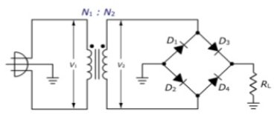
Full Wave Bridge Rectifier
The full wave bridge rectifier is designed to convert an AC sine Wave to a full wave pulsating DC signal.

Slide 16
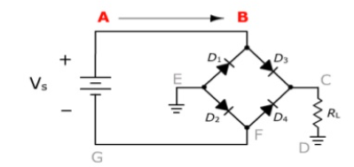
Full Wave Bridge Rectifier
The operation:
Since the top of the battery is positive

Slide 17
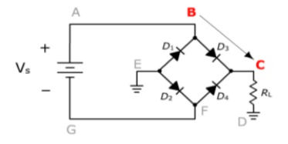
Full Wave Bridge Rectifier

Slide 18
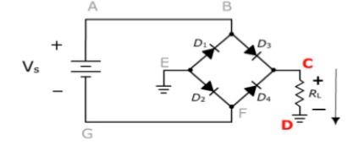
Full Wave Bridge Rectifier

Slide 19
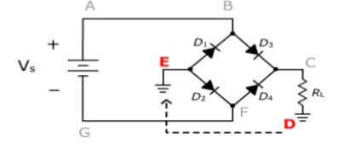
Full Wave Bridge Rectifier

Slide 20
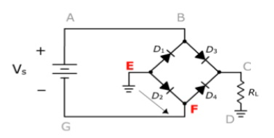
Full Wave Bridge Rectifier

Slide 21
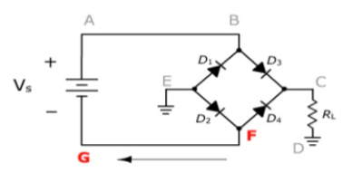
Full Wave Bridge Rectifier

Slide 22
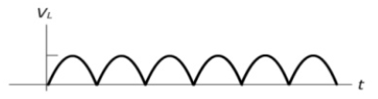
Full Wave Bridge Rectifier
Summary:
Positive Half Cycle:
Diode D3 is forward biased.
Diode D2 is forward biased.
Load voltage is Positive.
Negative Half Cycle:
Diode D1 is forward biased.
Diode D4 is forward biased.
Load voltage is Positive
The output waveform will appear as follows:

Slide 23
Thank you

